Slide 1
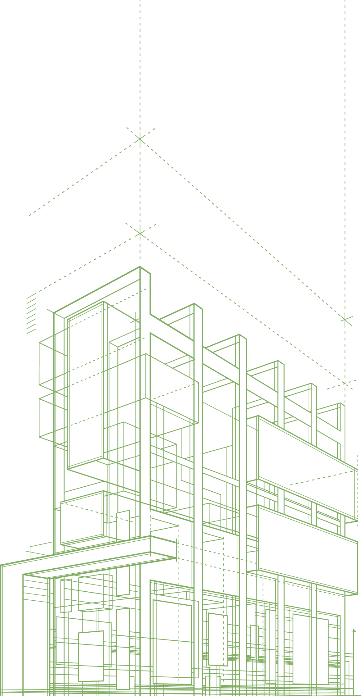

EXECUTIVE ROUNDTABLE
Hosted by: The Commercial Excellence ConsortiumTM
ACCELERATING
TRANSFORMATION
From managing change to leading rapid adaptation.
Notes:
Do not show this slide to a room. It is the file's cover. Start on the iceberg. Rule one of the whole choreography is slow down: the model only works at about half the pace it wants to run at.

Slide 2
“Change Management” is the tip of the iceberg
Stakeholder mgmt
Communications
Incentives & KPIs
Training Programs
Software Rollouts
ADKAR Model
Shallow
TM
Change
Management
Deep
Notes:
Stakeholder
Comms
Incentives
KPIs
WIIFT

Slide 3
TM
LIGHTNING POLL (enter Yes or No into the chat)
TM
Have you heard of ADKAR ?

Slide 4
TM
ADKAR Model – Developed by Jeff Hiatt in 1996
What must be true for a person to change?
A
D
K
A
R
Awareness
Desire
Knowledge
Ability
Reinforcement
What challenges does this still leave us with?

Slide 5
“Change Management” is the tip of the iceberg
Stakeholder mgmt
Communications
Incentives & KPIs
Training Programs
Software Rollouts
ADKAR Model
Shallow
Change
Management
Get People Moving
Deep
Notes:
Stakeholder
Comms
Incentives
KPIs
WIIFT

Slide 6
Outcome #1 – Get People Moving
How can we go from push to pull?
Resistance / Stalling
Compliance
Pockets of Commitment
Everyone
“All-In”
1
2
3
4
5
6
7
8
9
10
On a scale from 1 to 10, where would you say you are at?

Slide 7
“Change Management” is the tip of the iceberg
Stakeholder mgmt
Communications
Incentives & KPIs
Training Programs
Software Rollouts
ADKAR Model
Shallow
Change
Management
Get People Moving
Build In-House Capability
Deep
Notes:
Stakeholder
Comms
Incentives
KPIs
WIIFT

Slide 8
Outcome #2 – Build New Capabilities
How can we strengthen our organization and people?
Train & Hope
Renting
Expertise
Rapidly Assimilate
Innovate New Approaches
1
2
3
4
5
6
7
8
9
10
On a scale from 1 to 10, where would you say you are at?
Notes:
Very few get to resolve. And I am picking that word carefully. Commitment is easy to claim. I commit to things all the time that I half-do. Resolve is when you do it on the day you do not feel like it. [Then the rail.] Where would you say most of your experiences sit? ... And what would it mean for you if you were nines and tens? [Expect four to six. That is what makes them good clients.]

Slide 9
“Change Management” is the tip of the iceberg
Stakeholder mgmt
Communications
Incentives & KPIs
Training Programs
Software Rollouts
ADKAR Model
Shallow
Change
Management
Get People Moving
Build In-House Capability
Generate Topline Growth
Deep
Notes:
Stakeholder
Comms
Incentives
KPIs
WIIFT

Slide 10
Outcome #3 – Realized Growth Potential
How can we convert our efforts into new business?
Chronically Underperform
Updating Guidance
Consistently Overachieve
Hypergrowth
1
2
3
4
5
6
7
8
9
10
On a scale from 1 to 10, where would you say you are at?
Notes:
Very few get to resolve. And I am picking that word carefully. Commitment is easy to claim. I commit to things all the time that I half-do. Resolve is when you do it on the day you do not feel like it. [Then the rail.] Where would you say most of your experiences sit? ... And what would it mean for you if you were nines and tens? [Expect four to six. That is what makes them good clients.]

Slide 11
“Change Management” is the tip of the iceberg
Stakeholder mgmt
Communications
Incentives & KPIs
Training Programs
Software Rollouts
ADKAR Model
Shallow
Change
Management
Get People Moving
Build In-House Capability
Generate Topline Growth
Deep
WIN AT WORK
Notes:
Stakeholder
Comms
Incentives
KPIs
WIIFT

Slide 12
TM
AIRAS Model – Co-Designed by ComEx Consortium in 2025-26
How can we build intrinsic motivation, in-house capabilities
and adaptive capacity to drive transformational growth?
A
I
R
A
S
Align
Inspire
Reflect
Apply
Scale

Slide 13
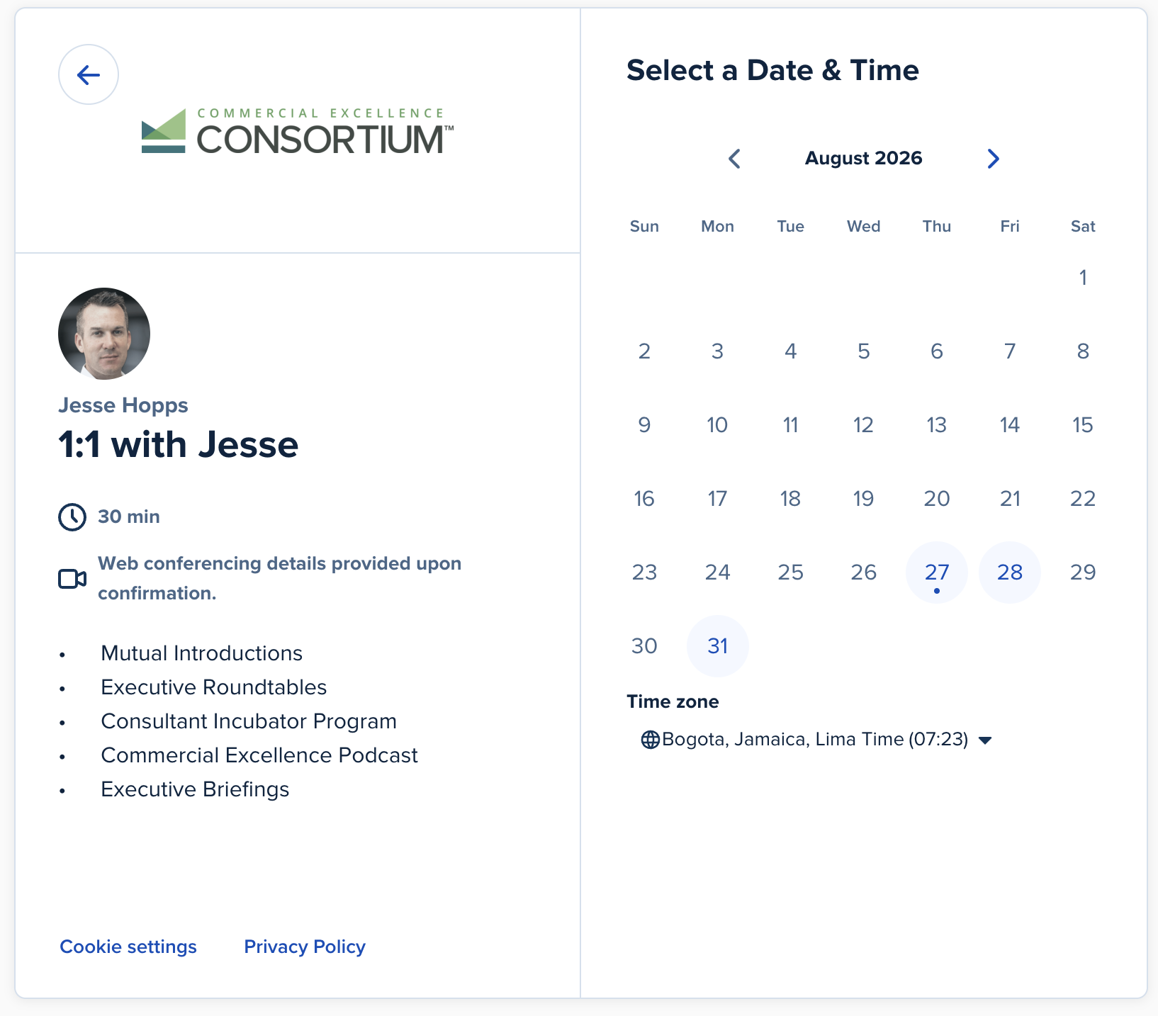
TM
Schedule a Private Briefing to discuss the Fellowship
Go a level deeper
Invitation-only, investment required
20 top enterprises currently invited
Executive Council membership
Work with us and Dr. Paul Stoltz
https://calendly.com/jesse-hopps

Slide 14
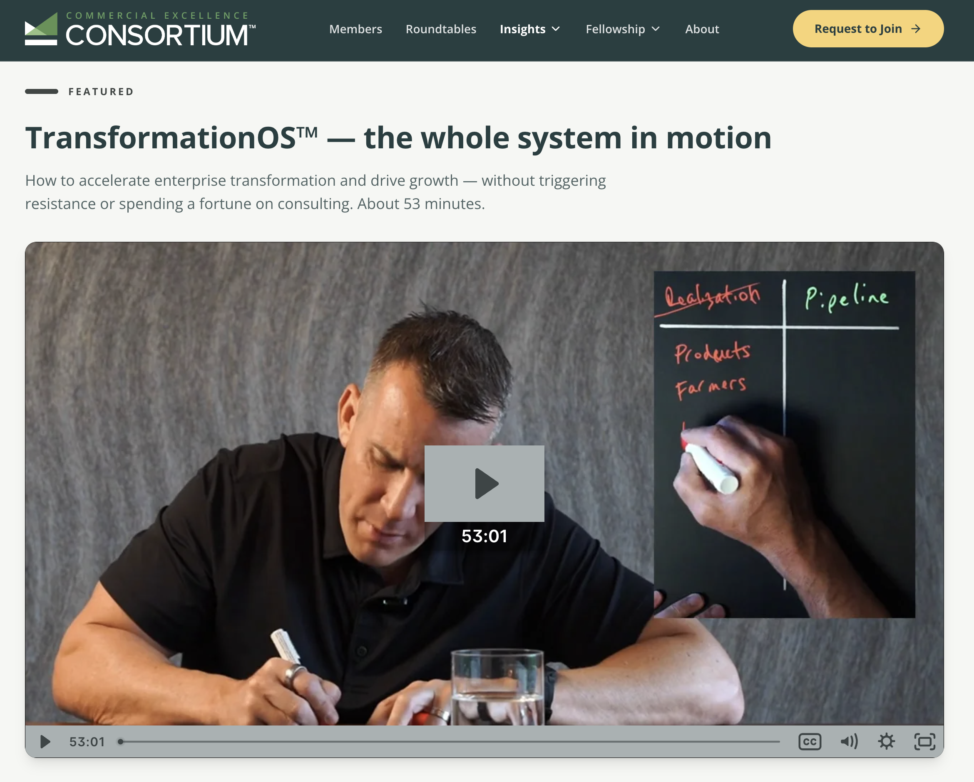
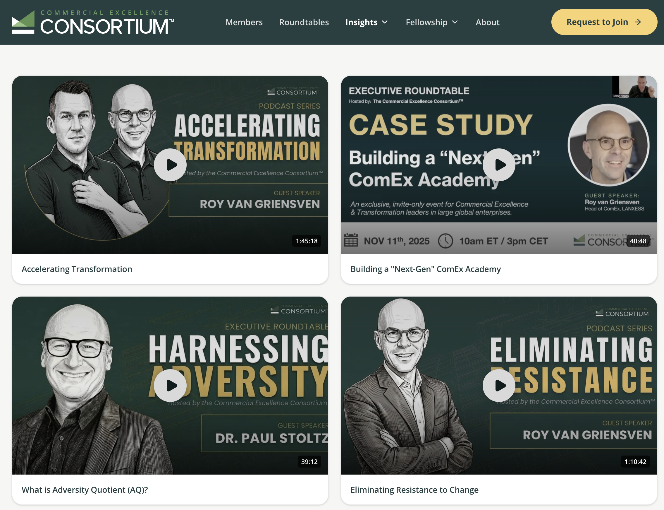
TM
TM
Learn more about AIRAS and the full TransformationOS
Watch the Masterclass video series:
https://commercialexcellenceconsortium.com/masterclass

